Slide 1

Air Mouse Motion Sensor
Dinesh S (CB.EN.U4AIE19025)
Kabilan N (CB.EN.U4AIE19033)
Sivamaran M.A.C (CB.EN.U4AIE19061)
Vijai Simmon S (CB.EN.U4AIE19068)

Slide 2
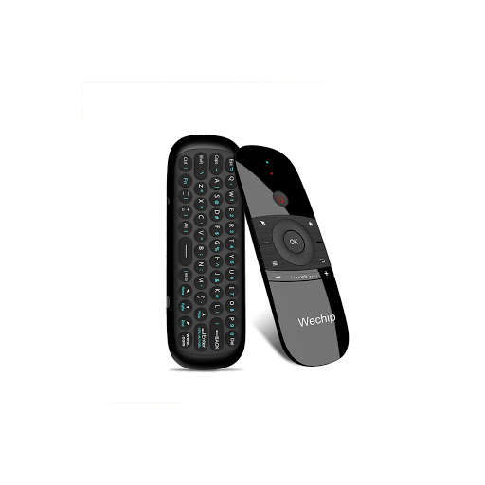
Content
Introduction
Components
Circuit Diagram and code
Workflow
Application
Conclusion

Slide 3
“Future of Computer is Pure Simplicity”
-Douglas Adams

Slide 4
Introduction
A mouse without wire is cool but what about a mouse that can move through air…..???
A mouse with motion sensor installed
Can detect the movement along the 2-D space
A leap of innovation in interactive computing & Gaming

Slide 5
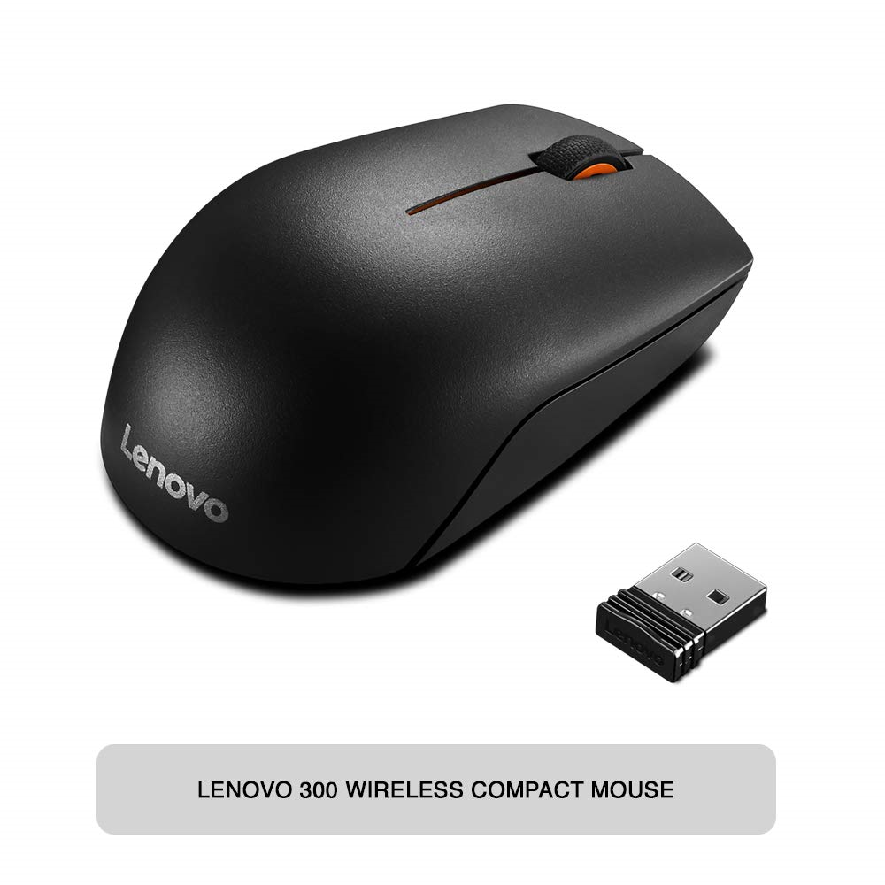
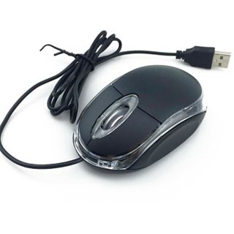
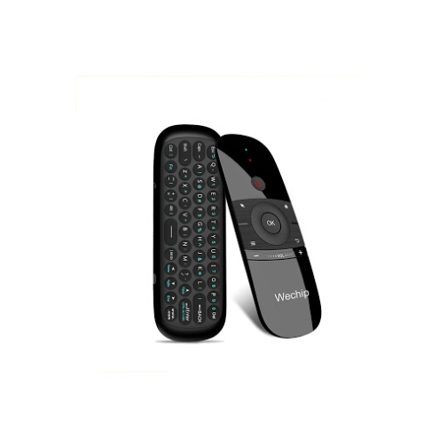
Our process is easy
first
last
second

Slide 6
Components
Arduino
It is the open source electronics platform , used for both hardware and software
Arduino boards are able to read inputs and turn it into an output.
Bluetooth HC-05 Module
It is designed for transparent wireless serial connection setup.
It uses the 2.45GHz
Frequency band.

Slide 7
Components
Accelerometer ADXL335 Module
It is small , low power , complete 3-axis accelerometer with signal conditioned voltage outputs.
Push buttons
it is a small, sealed mechanism that completes an electric circuit when you press on it and it is connected to an mechanical linkage.

Slide 8
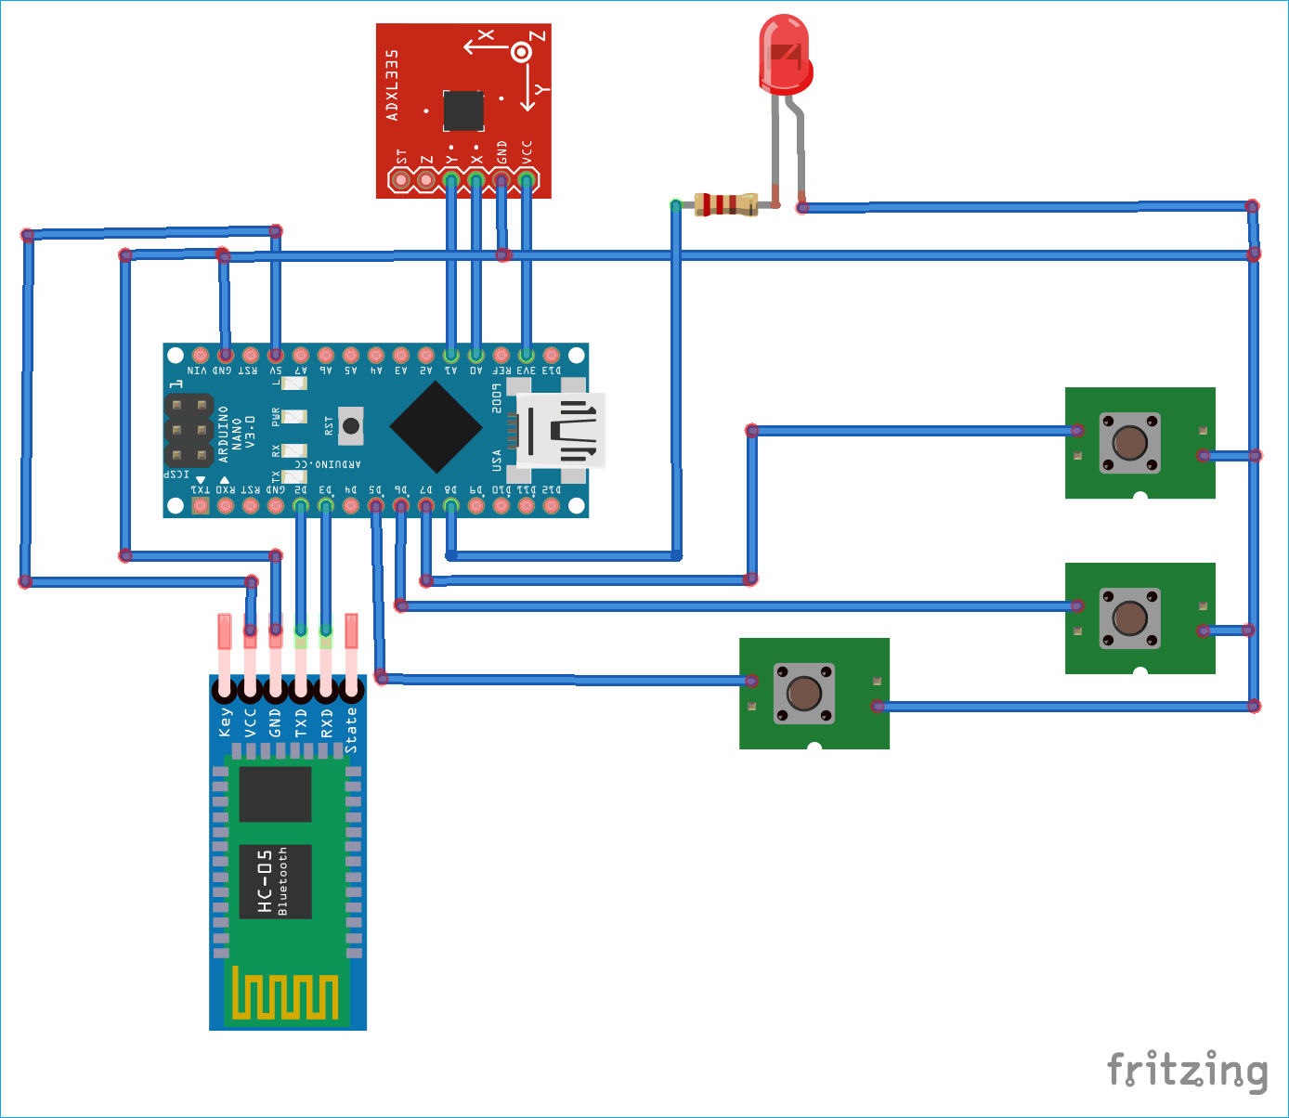
Circuit Diagram

Slide 9
Code
#include <SoftwareSerial.h>
const int rxpin = 2, txpin = 3;
SoftwareSerial bluetooth(rxpin, txpin);
const int x=A0;
const int y=A1;
int xh, yh;
int xcord, ycord;
const int trigger = 5;
int lstate = 0;
int rstate = 0;
const int lclick = 6;
const int rclick = 7;
const int led = 8;

Slide 10
Code
void setup(){
pinMode(x,INPUT); pinMode(y,INPUT);
pinMode(trigger,INPUT_PULLUP);
pinMode(lclick,INPUT);
pinMode(rclick,INPUT);
pinMode(led, OUTPUT);
digitalWrite(lclick,HIGH);
digitalWrite(rclick,HIGH);
Serial.begin(9600);
bluetooth.begin(9600);
}
void loop(){
digitalWrite(led,LOW);
while(digitalRead(trigger)==LOW)
{
digitalWrite(led, HIGH);
lstate = digitalRead(lclick);
rstate = digitalRead(rclick);
xh=analogRead(x);
yh=analogRead(y);
xcord=map(xh,286,429,100,999);
ycord=map(yh,282,427,100,800);

Slide 11
Code
Serial.print(xcord);
Serial.print(ycord);
if (lstate == LOW)
Serial.print(1);
else
Serial.print(0);
if (rstate == LOW)
Serial.print(1);
else
Serial.print(0);
bluetooth.print(xcord); bluetooth.print(ycord);
if (lstate == LOW)
bluetooth.print(1);
else
bluetooth.print(0);
if (rstate == LOW)
bluetooth.print(1);
else
bluetooth.print(0);
delay(4000);

Slide 12
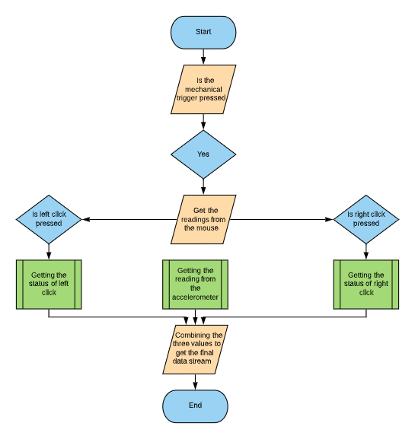
Workflow

Slide 13

Application
Low cost
Navigate Screen
Easy to control
Better Gaming
Diagram featured by http://slidemodel.com

Slide 14
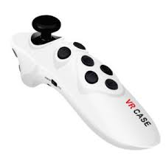
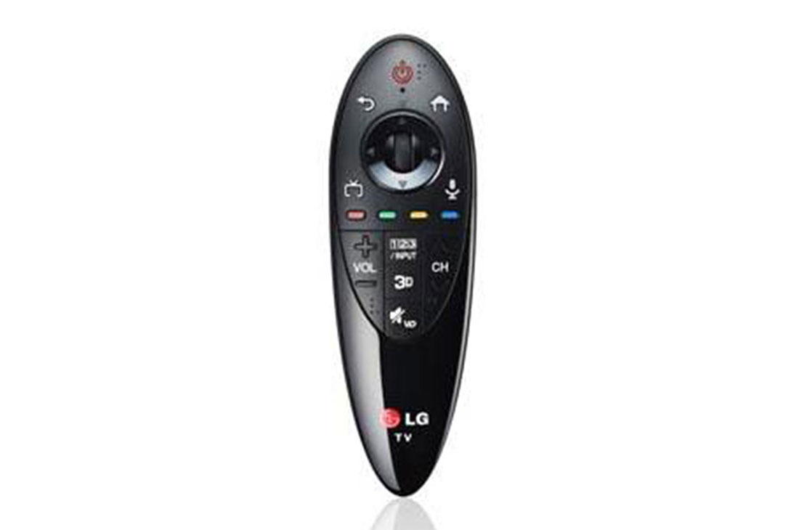
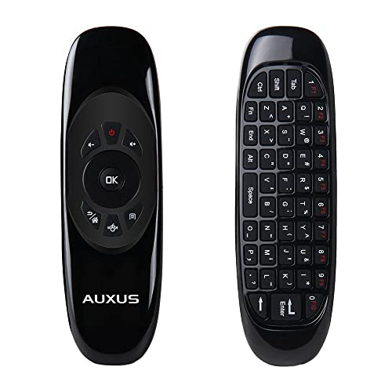
Application
Smart TVs use air mouse for navigation
This technology can be used in Virtual reality and augmented reality gamepads

Slide 15
Future Scope
Prototypes are being modelled for gesture based mouse and keyboard without requiring a physical mouse

Slide 16
Conclusion
The aim is to design an air mouse which does not require an mousepad , but tracts the hand movements
It eases navigation in smart TVs
It is a splendid navigation option
It can aid differently abled people
A increase in CAGR of product of 4.3% from 2019 to 2025 is expected

Slide 17

Thankyou

